Slide 1
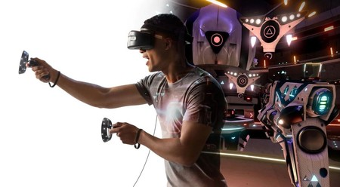
7th International CBR Conference
Rollins College / 13-15 October 2022
Evolving Consumer-Brand Relationships
& Brand-building Models
through Immersive Media Strategies
Theoretical Framework & Practical Applications
Dr. Silvia Cacho-Elizondo
IPADE Business School

Slide 2
Agenda
Introduction
Developing a Theoretical Framework
Main Brand-building models
New Immersive Technologies & Creative Brand Communications
Differentiating Mixed Reality & Immersive Media
Adoption Barriers
3. Methodology
5M framework
Analysis of 3 Case Studies: AFM / Tequila Patrón / Volvo
4. Main Contributions
5. Limitations & Future Research

Slide 3
1. Introduction
Digital and virtual environments have generated new creative and immersive platforms for brands
but …
They also represent new challenges for brand-building, positioning & differentiation.
21.6% per year
How companies and brands could better engage their audiences and communicate with them in immersive platforms without losing relevance and strategic vision for their brand-building processes ?
$62.1 billion USD
by 2027

Slide 4
2. Developing a Theoretical Framework
Virtual (VR)
Augmented (AR)
&
Diminished (DR) Realities
Mixed Reality
& Immersive Media
Brand-building Models
Adoption Barriers
Brand Communications & Brand-building processes
are facing a true Digital Transformation.

Slide 5
Brand-building Models
"Innovation distinguishes between a leader and a follower“
Steve Jobs
This process is a continuous, consistent, and an ongoing process making a constant impact on the minds of customers of the brand´s latest offerings of products and services.
The main brand-building models identified are:
AIDA (Attention-Interest-Desire-Action) Model
Keller´s Customer-based Brand Equity Model (CBEE)
Aaker´s Brand Equity Model
BAV Model
Notes:
The basic hierarchy of effects model represents a mental process that a consumer is supposed to experience through an advertising communication campaign. To fully understand how this operates, advertisers must focus on each individual step of the process, as well as on the concept as a whole.
AIDA model however does not fully consider the emotional aspect that is often addressed in advertising and that advertising psychology recognizes as a key factor.
CBEE model: For Keller, when a brand incorporates both rational and emotional aspects, it fosters multiple points of customer access, reducing its vulnerability to competition. Brand relationships / Brand response / Brand Meaning / Brand Identity
For Aaker, building a long-lasting brand equity progressively helps the organization to choose a premium position, demanding premium prices and consequently, obtaining higher profits.
BAV Model : Was developed by the advertising agency Young and Rubicam (Y&R). It provides comparative measures of brand value of thousands of brands in different categories. Brand Value ( Brand Vitality / Brand Stature). Brand Vitality ( Differentiation and Relevance). Brand Stature (Esteem and Knowledge)

Slide 6
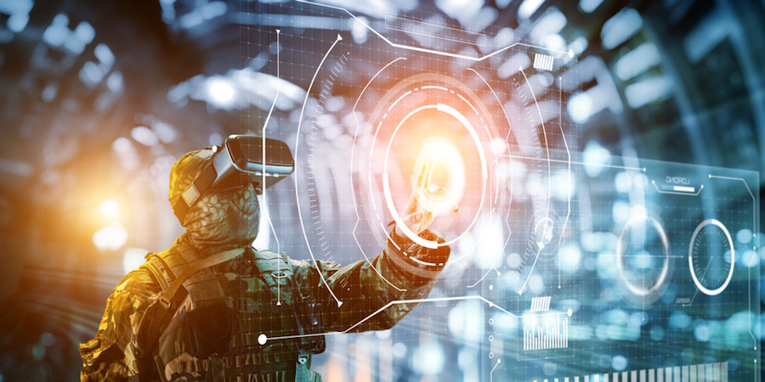
New Immersive Technologies & Creative Brand Communications
Virtual environments have allowed brands to find new forms of differentiation, but they also represent new challenges in terms of brand positioning and relevance.
Hyper-connectivity & new immersive technologies (NIT) have fostered dramatical changes, increasing the complexity of brand-building processes and consumer-brand interactions to manage.
(Rivera et al., 2021).

Slide 7
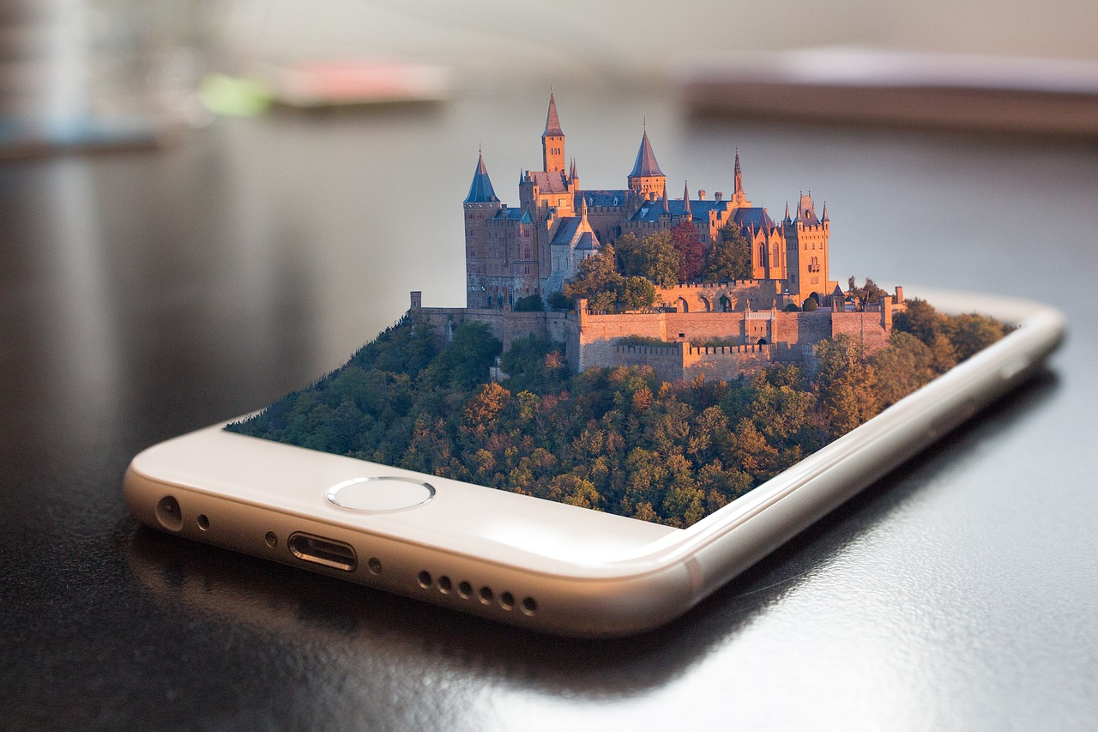
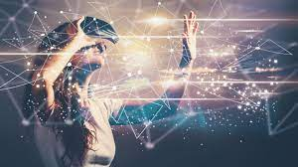
New Immersive Technologies & Creative Brand Communications
Virtual Reality (VR)
Diminished Reality
(DR)
Augmented
Reality (AR)
The technology allows the creation of a new dimension in which it is possible to interact with any other person, object, character and/or brand.
This computer-generated environment makes users feel as if they are physically in this virtual world by providing real time simulations and interactions using distinct auditory, visual, tactile, and olfactory sensory channels (Burdea, 1993).
This is an «enriched» or «augmented» environment which combines physical and intangible spaces and objects.
This new environment gives users, like brands, the ability to create avatars, images, objects, or texts through a computer.
In AR, brands could superimpose virtual elements onto the real world by providing additional relevant information to the environment the user/consumer is actually seeing.
DR consists of the use of techniques extracted from augmented reality, but with the opposite objective, allowing users/brands to subtract or eliminate real objects (Azuma, 1997).
This extraction of objects could be useful in brand narratives and gamification strategies.

Slide 8
3. Methodology
For the initial stage of this research, we focused on a literature review of articles, case studies, blogs and books related to virtual, augmented and diminished realities as well as artificial intelligence and holograms.
Deep interviews with experts and executives in Mexico, Spain and the United States. who are already applying these technologies.
We used a simplified 6M Integrated Marketing Communications (IMC) framework (Dolan, R., 2000), which take into consideration, only 5 of the 6M:
Mission (objectives)
Market (target markets)
Message (to be communicate)
Media (media mix to be used)
Metrics (KPIs to be used).

Slide 9
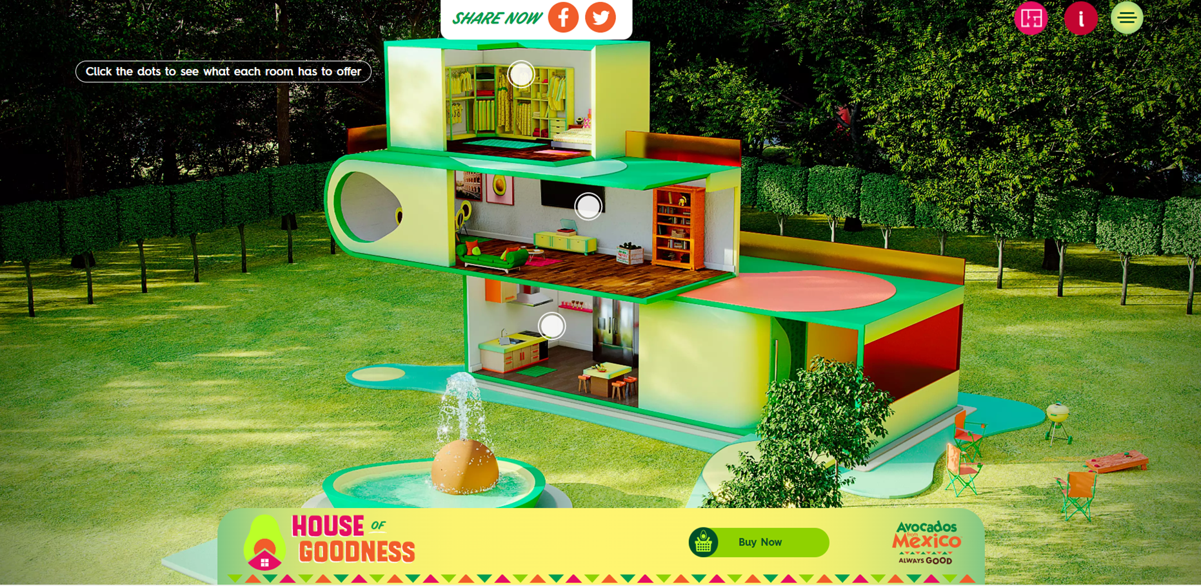
Case Study 1: Avocados from Mexico (AFM)
Multi-channel Shoppable Campaign &
House of Goodness, boosting sales in all channels
Mission: Drive brand awareness and engagement across all key social platforms, while also increasing purchase intent and placing avocados on the digital shelves of 40 retailers.
Market: Super Bowl´s audiences & Retailers
Message: As consumers continue to buy more of their groceries online, AFM is leading the way by ensuring all digital and social media channels are shoppable with MikMak platform.
Media: The virtual home features several spaces and unique experiences that consumers can navigate through, this include a selfie with Drew Brees, watching the brand's Big Game TV spot, discovering new guacamole recipes, and also purchasing avocados directly at the many shoppable touchpoints across the experience. House of Goodness visitors will also enter a sweepstakes for a chance to win their very own "House of Goodness" with a $100k smart home makeover.
Metrics: Brand awareness, Customer
Engagement, Purchase Intent,
Brand Impressions.

Slide 10
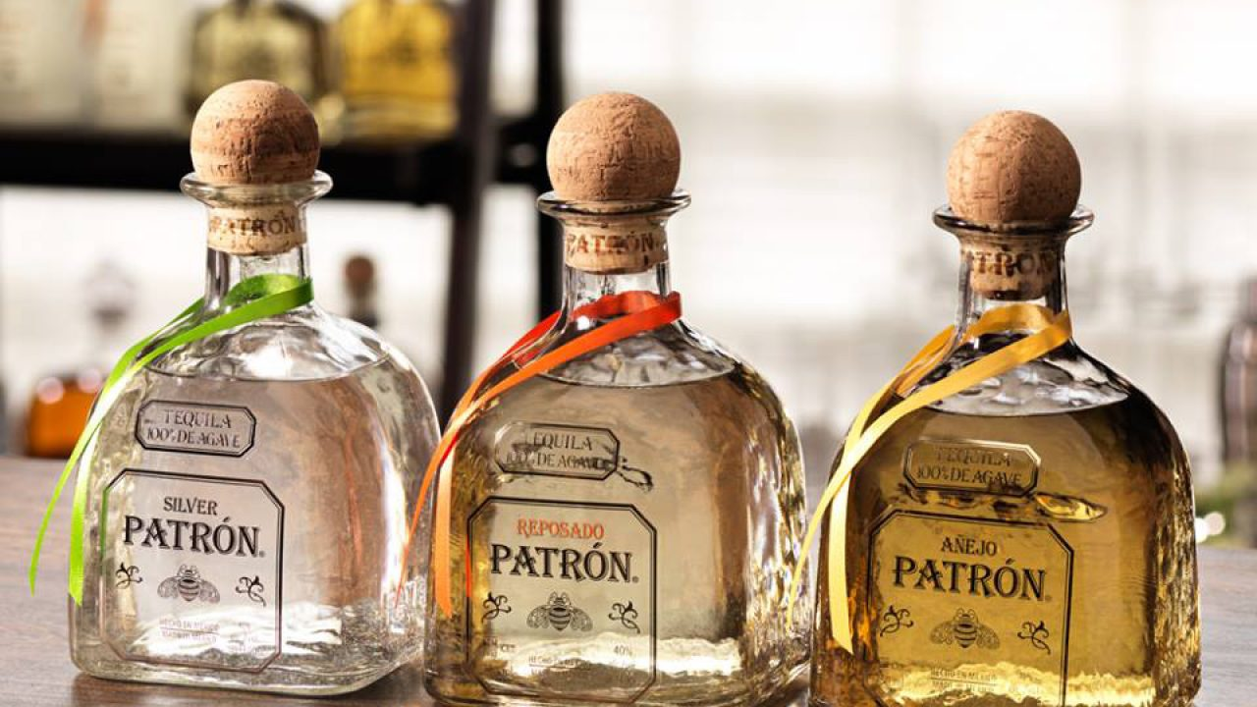
Case Study 2: Tequila Patrón
Brand Storytelling using AR, supporting Global Expansion with Brand Authenticity
Mission: Become the leading super premium brand in the tequila´s country-of-origin and use digital tools to tell the brand´s storytelling worldwide using “La Hacienda” as a key character. Enhance brand authenticity
Market: Final consumers, Distributors and Salesforce, Gate keepers, Mixologists and worldwide Distributors.
Message: Mixing consumer´s reality with brand´s reality through the visit of Hacienda Patron distillery, support the brand authenticity. An authentic. Artisanal and Mexican tequila
Media: Oculus Virtual Reality Experience & the AR App.
Metrics: Brand Authenticity, Brand Awareness,
Customer Engagement, Sales.

Slide 11
Immersive Virtual Reality La Hacienda Patrón
Notes:
Duración: 2 minutos 40 segundos

Slide 12
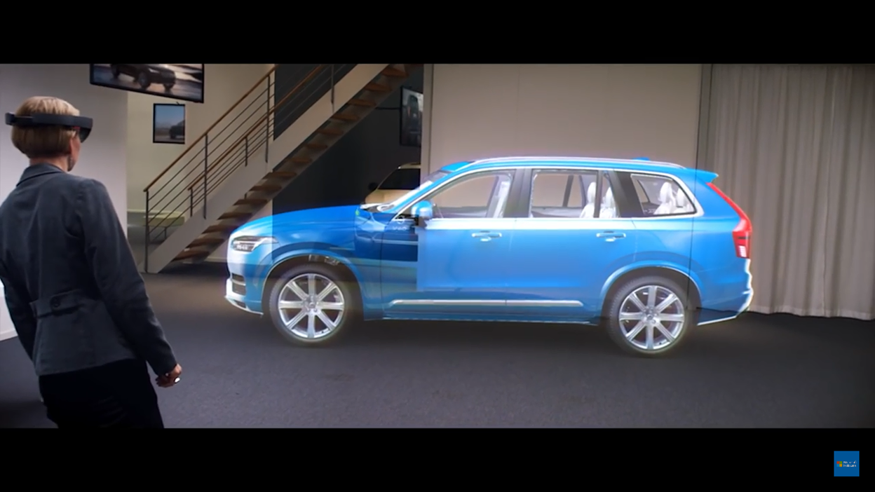
Case Study 3: Volvo
Highlighting the Brand´s key differentiator
in a more experiential and safe way
Mission: Offer a new and exciting way to experience the brand's cars and their attributes. Volvo wants customers to take a virtual rides in their cars before they actually get behind the wheel, improving the buying experience.
Market: Customers, Car Dealers and Salesforce.
Message: Security as a key differentiator of the brand.
Media: Microsoft HoloLens, a powerful holographic laptop.
Metrics: Brand Awareness, Customer Engagement and Sales.
Microsoft HoloLens Partner Spotlight with Volvo Cars

Slide 13
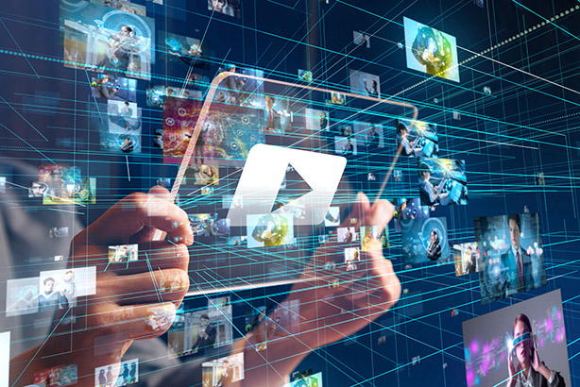
4. Main Contributions
New hybrid and augmented marketing needs to help them build multi-channel brand ecosystems where consumers can seamlessly transition from one communication platform to another, leading to more immersive, innovative and authentic brand experiences.
Through the analysis of three practical applications, using the simplified 5M framework, we were able to examine how three different brands in three different product categories have used virtual & augmented technologies for different strategic branding purposes.
5. Limitations & Future Research
Many questions remain to be answered. A deeper and more structured theoretical framework is still needed to guide marketers and academics in the new hybrid reality of marketing.
In addition, it is necessary to carry out extensive qualitative and quantitative research to better assess the impact of immersive technologies on the consumer-brand relationships, evaluating positive and negative effects in depth.
Brands need to adapt and improve their communication & brand-building models to differentiate themselves in this emerging and challenging hybrid world.

Slide 14
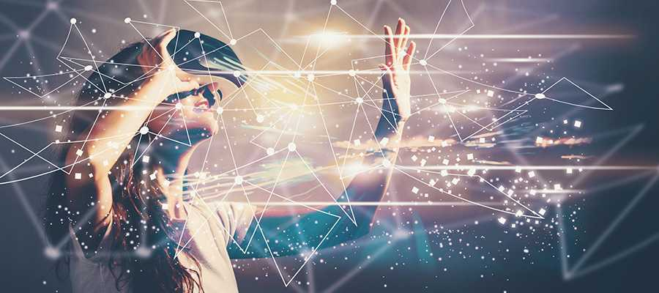
Thank you!
Dr. Silvia Cacho-Elizondo
s.cacho@ipade.mx / @SCacho_Elizondo

